Slide 1
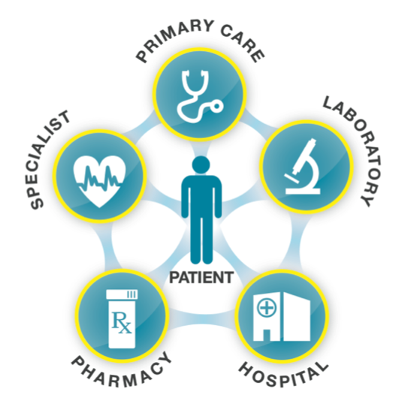
Health Data Science:
November 14, 2018
An ethical battleground of the modern age
LASR Think Tank (Group 1):
Alvin Tan, Spyros Garyfallos, Lina Gurevich, Ross MacLean
For US Department of Health and Human Services
Notes:
Thank you for joining us in today’s topic of discussion - “Health Data Science: An ethical battle ground of the modern age”.
Our target audience is the US Department of Health and Human Sciences which is responsible for regulating the sharing of health data.

Slide 2
Polarizing Perspectives
Health data is abundant but reuse raises ethical questions.
Liberal
Advances medical understanding.
Superior to clinical trials.
Conservative
Prone to misinterpretation.
Detrimental to patient-doctor relationship.
Notes:
Each day vast amounts of data are being collected on every aspect of a patient’s medical life. This data serves an immediate need, but > should it be reused ? and if yes...
> what are the ethical implications of doing so?
Advocates for more liberal data sharing believe that analysis of this real-world data will help advance medical understanding.
>> its scale and cost makes this approach advantageous over clinical trials.
Traditionalists believe that data access should be regulated more stringently because the potential for misinterpretation is too great. Furthermore, trust is the foundation of the patient-doctor relationship and liberal data sharing would erode this.
With the ascendancy of Data Science, it is now possible to tap into health data like never before. . . but just because we can, does that mean we should?

Slide 3
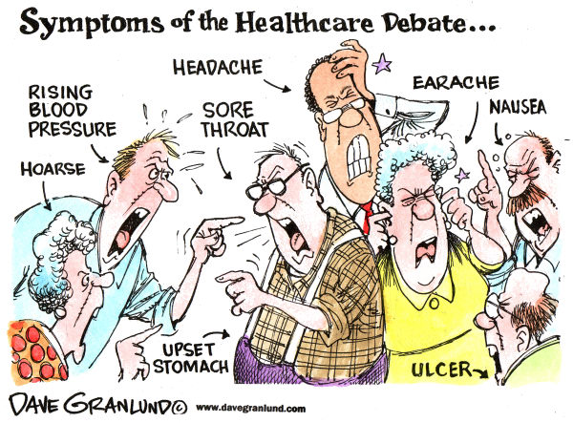
Data Usage in Healthcare
Confidentiality Agency Group
LASR Think Tank
Notes:
To help us answer this question, we have with us a panel of experts:
Spyros Garyfallos from the Confidentiality Agency Group, is interested in preserving patient confidentiality rights.
Lina Gurevich and Alvin Tan from LASR Think Tank, advocate advancing the application of Data Science across this industry.

Slide 4
Controversy I:
Data shall be used only for the purposes it was collected
Notes:
Controversy number 1 - Spyros, should health data be reused?

Slide 5

Data quality
Notes:
No, and to explain why, let’s start with the data quality. In 1991, Johan van der Lei wrote that data shall be used only for the purpose for which they were collected, and called this the 1st Law of Medical Informatics.
This law is supported by a vast list of known data quality issues that surround electronic health records and other routine databases in health care.

Slide 6

Unknown recording habits
Notes:
Another major issue with uncontrolled studies is the lack of information on the data recording process.
Studies show that the annual average proportion of problematic data entry encounters ranged from 5% to 60% per physician.
Another study in 2009 showed that heterogeneity of, and non-adherence to data collection protocols led to an erroneous assessment of increasing ischaemic myocardial infarction incidence

Slide 7
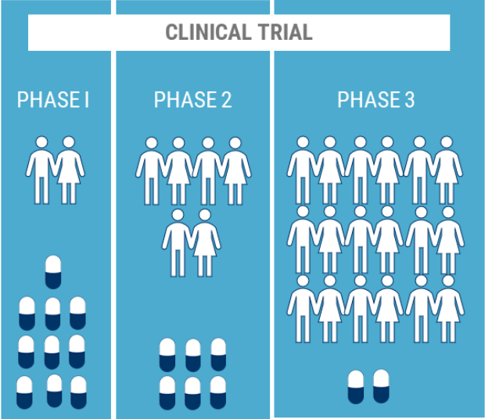
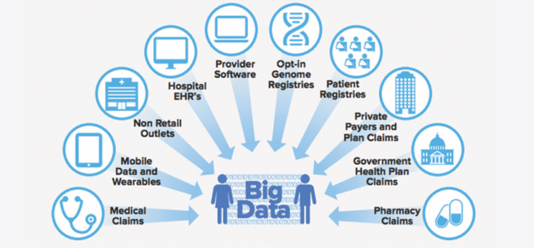
Real-world Data = Real Clinical Knowledge
VS.
Notes:
Traditionally, the evidence about effectiveness of medical treatments is based on data generated through randomised clinical trials, which are conducted under tight controlled conditions and with limited groups of patients.
On the other hand, data that are routinely collected from a wide variety of sources within the healthcare system provide information that is a more complete representation of the real-world patients. Hence, the clinical knowledge derived from such data can promote more effective diagnostics and treatment.

Slide 8
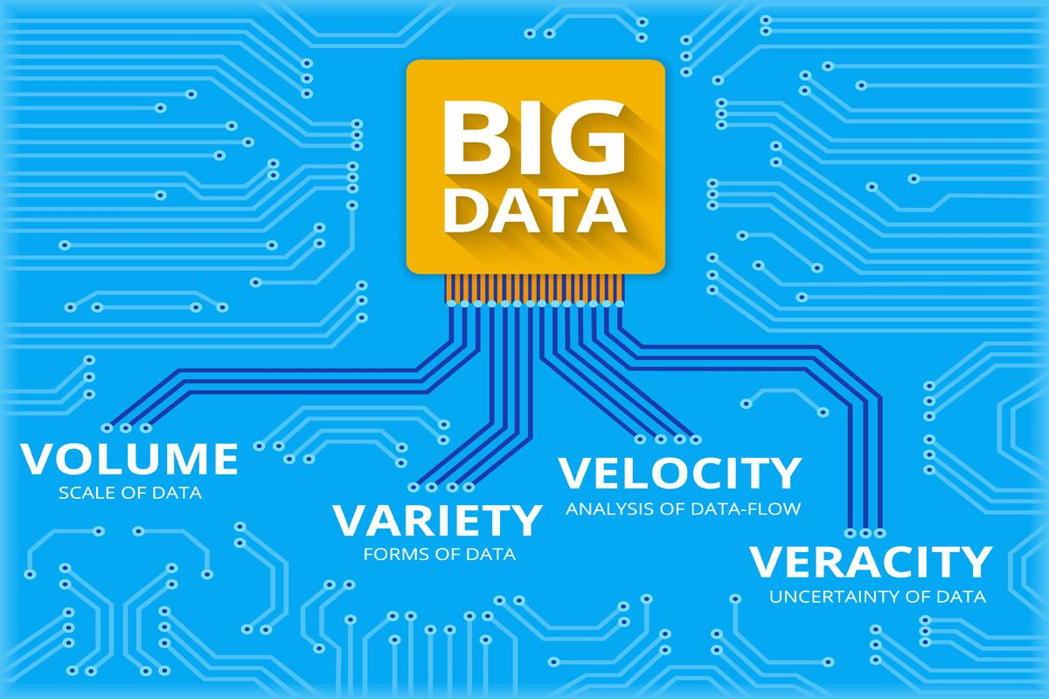
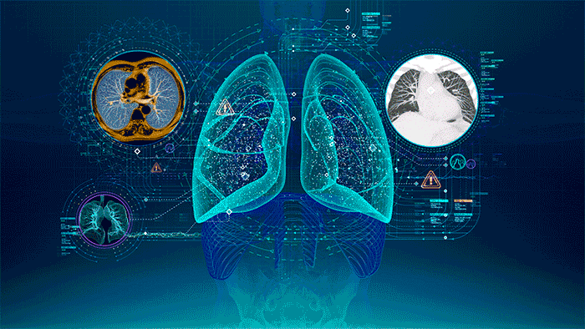
Big Data: Diagnostic, Treatment, Assessment
Notes:
In addition, re-using routine data for research creates the opportunity to analyze very large datasets with very long follow-up times.
This, in turn, will allow us to find answers to questions that could never be answered with traditional studies.
For example, what are the effects of diagnostic medical radiation exposure on cancer risk? Or what are the actual health benefits of the smoking bans?

Slide 9
Controversy II:
Big Data can never replace traditional medical research methods
Notes:
Thanks Lina. Controversy number 2 - Spyros, please.

Slide 10
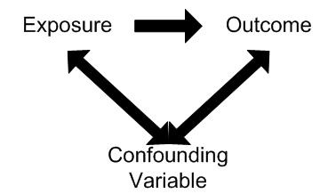
Confounding bias
Notes:
In uncontrolled research studies we cannot exclude that the results are subject to confounding bias.
The presence of confounding means that the exposed group is essentially different from the unexposed groups at baseline

Slide 11
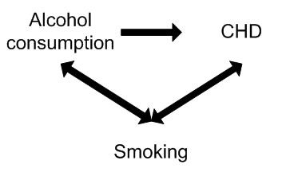
Confounding bias example
Notes:
For example, a study found alcohol consumption is associated with the risk of Coronary Heart Disease or CHD. However, smoking may have confounded the association between alcohol and CHD. For example smoking is independently associated with CHD and is also associated with alcohol consumption, since smokers tend to drink more than non-smokers.
##Bigger data sets are not going to solve this problem. Larger denominators can help reduce variance—but not bias.
They merely bring the risk that we fool ourselves more often because there will be more “statistically significant” results.

Slide 12
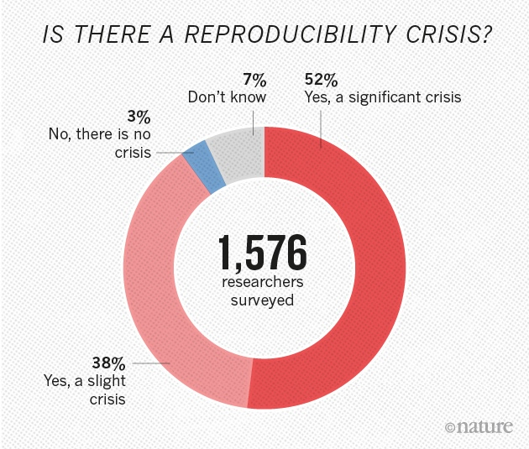
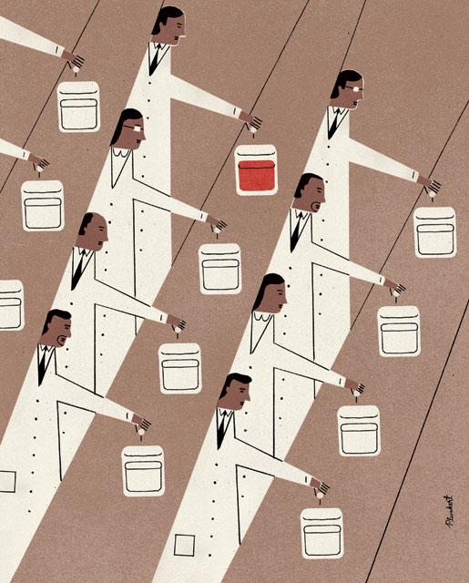
Random Clinical Trials: Reproducibility Crisis
Notes:
Despite the efforts to regulate the drug discovery process, the majority of positive trial outcomes cannot be reproduced by independent parties.
The pharmaceutical industry has been accused of manipulating trial parameters and of dodgy practice of selective publishing.

Slide 13
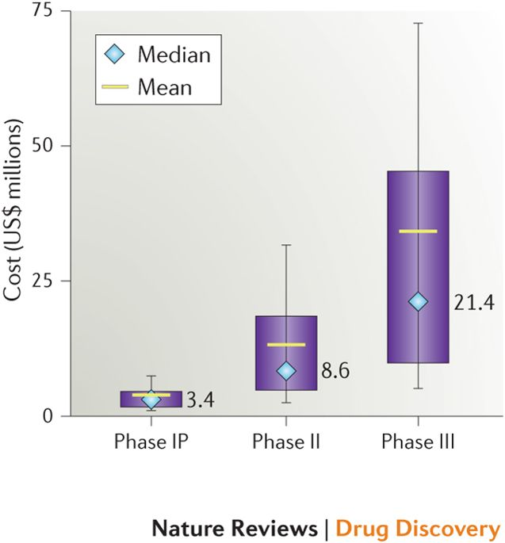
Random Clinical Trials: High Costs
Notes:
In addition, The US Department of Health and Human Services has estimated that the average clinical trial costs are $40m per drug.

Slide 14
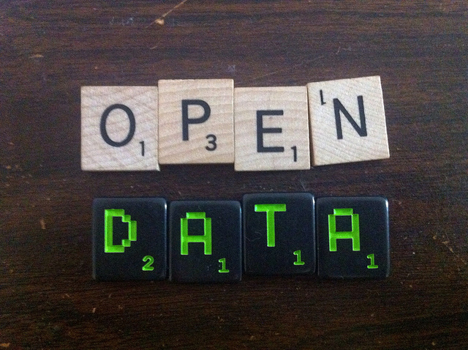
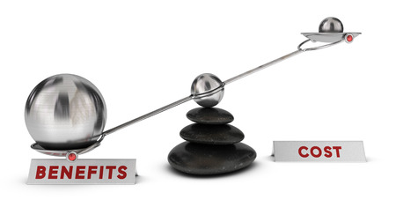
Existing Datasets = Cost-effective Research
Notes:
Contrary to this, routine data have the ability to provide evidence of safety and efficacy of medical treatments for a fraction of the costs of trials, and within representative populations and settings.
Because the costs are low, research using such data sources can be publicly funded and avoid commercial biases.

Slide 15
Controversy III:
Health data shall never be reused for research without explicit consent of the patients
Notes:
Thanks again, Lina. Controversy number 3 - Spyros, take it away.

Slide 16

Trust
Notes:
Patients must be able to trust doctors with their lives and health and an essential element of that trust relationship is the promise to treat patients as individuals and respect their dignity and their right to confidentiality.
Without assurances about confidentiality, patients may be reluctant to seek medical help or to give doctors the information they need in order to provide good care.

Slide 17
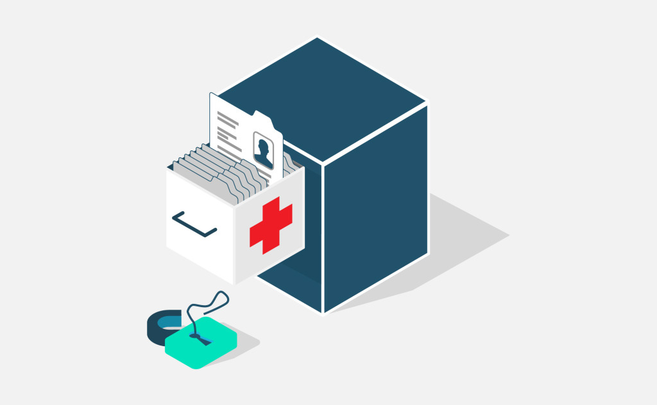
Social Licence for Research
Notes:
In 2013, an English programme known as “Care.data” was suspended and eventually aborted because it raised major public concern. The goal of this programme was to upload and link primary care data for commissioning and research purposes.
Ethicists have argued that the programme failed to respect the core values for a “social license for research”. That concept describes how the expectations of society regarding some activities may go beyond compliance with the requirements of formal regulation; those who do not fulfil the conditions for the social licence may experience ongoing challenge and contestation

Slide 18
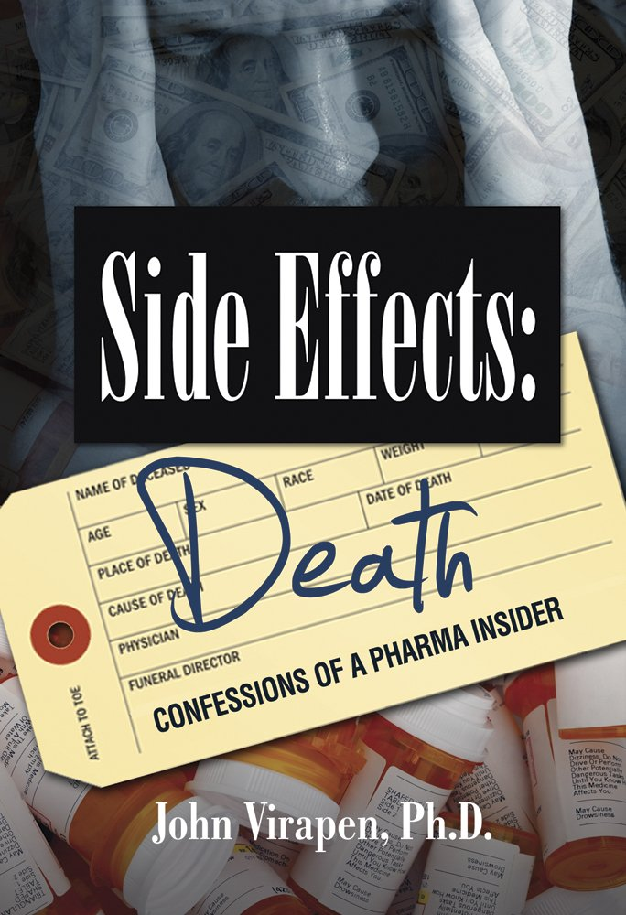
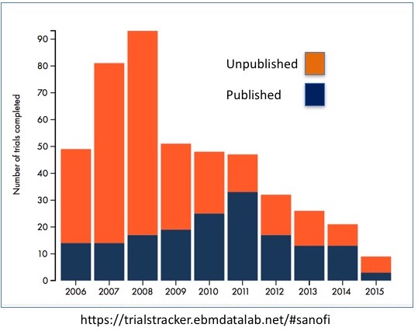
Risks of Non-sharing Clinical Data
Notes:
While there are legitimate concerns about privacy breaches and misuse of patients’ data, one could also argue that there are risks due to the non-sharing of health data.
There have been devastating examples where non-publication of research findings and withholding data about detrimental side effects have been linked to harm to individuals.

Slide 19

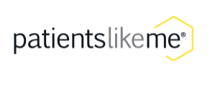
Patients Advocate for Data Sharing
www.usemydata.org
www.patientslikeme.com
Notes:
A compelling argument in favour of the sharing of health data is the fact that many patients ask for it.
Several online patient communities advocate the use of their own data for research.

Slide 20
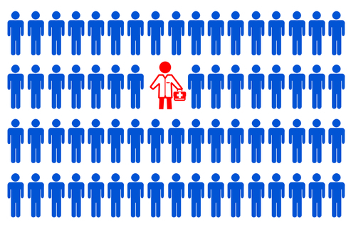
High Costs of Obtaining Patients’ Consent
Laborious
Expensive
Time Consuming
Impossible for some patients
Notes:
Obtaining consent of all the patients whose data are being used in retroactive research studies would be a high cost operation without providing tangibly improved privacy.
Moreover, it would not be possible for patients with serious mental illness or patients who have died.

Slide 21
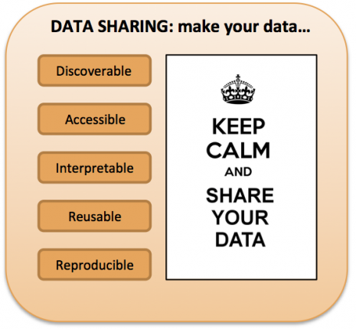
Solution for Reproducibility Crisis
Notes:
To maintain the integrity and trustworthiness of science, it is necessary to cultivate practices that facilitate reproducibility:
fewer barriers for researchers to access health data is one of them!

Slide 22
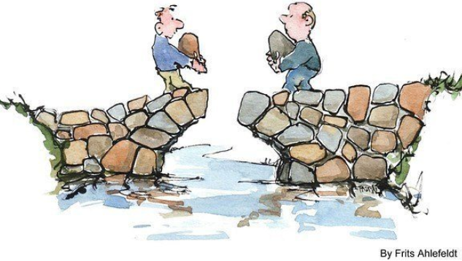
De-identification of sensitive data
The Third Way: A compromise
Notes:
> Next, let us elaborate on a compromise that we hope to achieve in this ‘Third Way,’ which is to turn personal data into anonymous yet descriptive data.
> To be clear, anonymizing involves having names, places and other identifying features disguised across a data set.
#####
By de-identifying data to the extent of anonymizing its source, scientists may analyze and share data, the clinician can use these findings, and ultimately, the patient will benefit from the whole exercise in terms of effective new treatments.

Slide 23

Addressing the Controversies (I)
Fitness of routine data for research
Imprecise data outside context
Misinterpretation
Not ethical issue; let data scientists decide
Notes:
>> Recall that van der Lei’s actual concern was that health data could easily be misinterpreted outside the context where they were collected;
>> Thus it was not an ethical issue, but one of data suitability.
=> I say, let it be a problem for data scientists to rationalize and solve for (but do not forbid it); after all, even in controlled experiments today, data scientists are trained to filter biased data and extricate fallacies, to improve fitness of data.
#####
This is an issue of imprecise data collection leading to inappropriate test conditions to draw conclusions from.
=> once a diligent process of data selection process is conducted, followed by the collection of sufficient high quality and high fidelity data, we are positioned to exploit the sheer amount of such data collected over the decades. For example, it could an alternative to costly and (obviously) time-consuming longitudinal studies.

Slide 24
Addressing the Controversies (II)
Big data to answer everything at the cost of understanding causality
Analytical versus probabilistic
Inductive versus deductive
Not an issue unique to this field; let data scientists rationalize
Notes:
> The second controversy involves weighing between two rigid approaches:
> Can big data and machine learning be used to answer all research questions, or,
> Is there no replacement for randomised experiments when we are interested in causation.
> And again, this is not an issue that is unique to today’s discussion.
> Yes, we agree that anonymized data may impede causal inference, but it does not necessarily diminish the potential. Data scientists can adopt a middle ground. For instance, although de-identified, some benefits of randomized trials can still be achieved through high-level patient groupings.
#####
=> We can expect these achievements only to accelerate in the future, thus paving the way for the new type of clinical research based on anonymized data that would eventually marginalize the role of traditional clinical trials.
Besides, in the last decade, new advances have been made both in statistical methods and in the field of machine learning that allow making causal inferences from observational data.
Essentially, this controversy is not dissimilar to striving for analytical versus probabilistic solutions, or inductive research methods versus deductive ones. This Third Way explores a hybrid application in all of the above.

Slide 25
Addressing the Controversies (III)
Privacy breaches
Ethically wrong to share patient-doctor consultation notes
Anonymize data; let data scientists use pattern recognition techniques
Notes:
> The main premise of the Third Way actually addresses this ethical controversy head-on:
=> Once this hurdle is removed, there is no reason not to use the data for research purposes.
#####
The underlying issue of the patient privacy is the concern that a patient's data will be used in a way harmful for the patient (for example, a detrimental effect it might have on his or her insurance coverage or job prospects).

Slide 26
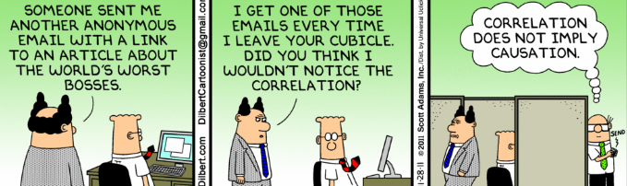
Side benefit of anonymity and confidentiality
Redact subject origin
Eliminate fallacies
Improve research accuracy
Notes:
> So, the challenge is not whether to do it but how to do it.
> We will strive to develop reliable techniques for anonymizing patient data whilst imposing strict regulations whenever the data is being collected for research purposes.
>> This Third Way has a critical requirement: when we implement anonymized data research, it has to be comprehensive; i.e., we cannot just utilize data from patients who agree to release their health data - otherwise, we run into selection bias.
But, we also have a side benefit: anonymizing certain characteristics of data may in fact help to destigmatize certain fallacies.
#####
As with any solution, we first caveat its risks:
1. Data anonymization risks the loss of data context.
2. It can be difficult to disguise data identity without introducing an unacceptably large measure of distortion into the data, which may exacerbate the suitability concern.
In de-identifying patient data like location, conclusions may avoid biases associated with subject origins. This may in fact improve research accuracy.

Slide 27

Third Way is The Best Way
A synergy of perspectives will yield the most robust solution.
The Third Way offers such compromise:
Entrust data scientists to determine suitability.
Anonymized research datasets.
Notes:
> To summarize,
The Third Way, our compromise solution, offers the following takeaway:
We must entrust our data scientists to make informed judgements about the suitability of analytic approaches;
The use of an anonymized research datasets is a necessity, as we must preserve patient confidentiality and honor the sanctity of the patient-doctor relationship.
We hope this discussion will provide a framework for regulatory standards in the industry going forward. Thank you for joining us.
#####
It is clear that if we are to unlock the true value of health data then there must be a synergy of ideologies; and we must find a solution that alleviates concerns aired here today while delivering the rich potential of the data.
Concerns about data sharing are valid but thoughtful integration of the spectrum of opinions will ensure that Data Science evolves into a robust discipline that augments existing practices and contributes to medical advancement.

Slide 28
References
https://link.springer.com/article/10.1007/s41060-018-0109-y#Sec2
https://sites.google.com/site/andreakeportfolio/practicum-4-and-5/healthcare-delivery
https://www.medgadget.com/2018/04/big-data-in-healthcare-market-value-share-of-20-69-with-cerner-co-cognizant-dell-philips-siemens-and-business-forecast-to-2022.html
https://www.cbinsights.com/research/clinical-trials-ai-tech-disruption/
https://www.ge.com/reports/software-please-doctors-looking-ai-speed-diagnosis/
https://idmprogram.com/the-corruption-of-evidence-based-medicine-killing-for-profit/
https://www.ebi.ac.uk/training/online/course/functional-genomics-iii-submitting-your-data-and-f/why-should-you-share-your-data
https://www.hopkinsmedicine.org/news/publications/hopkins_medicine_magazine/features/fall-2017/could-you-repeat-that
https://bmcmedethics.biomedcentral.com/articles/10.1186/s12910-017-0184-y#Abs1
https://www.ncbi.nlm.nih.gov/pmc/articles/PMC4431337/
https://www.healthknowledge.org.uk/e-learning/epidemiology/practitioners/chance-bias-confounding

Slide 29
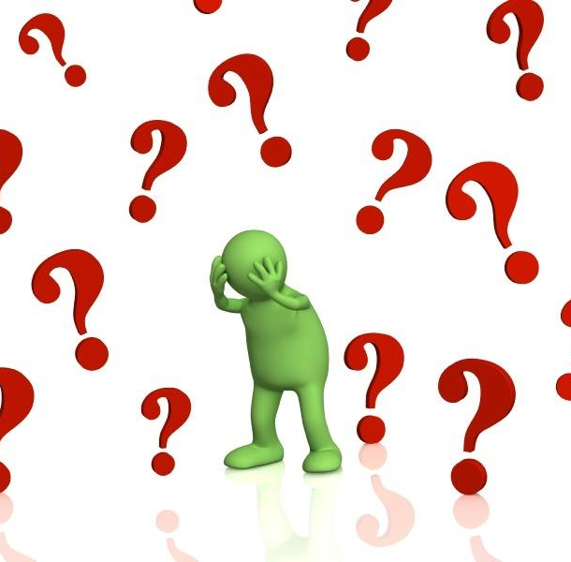
Data Usage in Healthcare
Thank you for joining us today!
Q&A
LASR Think Tank (Group 1):
Alvin Tan, Spyros Garyfallos, Lina Gurevich, Ross MacLean
For US Department of Health and Human Services

